Slide 1
Cardiopulmonary resuscitation (CPR)
Mulualem Sitot (BSc, MSc in Anesthesia)
Assistant professor, Department of Anesthesia
Addis Ababa University

Slide 2
Outline of the presentation
Definition
Introduction
Incidence of CA
Reversible causes of CA
Causes of ICU-CA
Signs of cardiac arrest
Components of resuscitation from CA
Summary

Slide 3
Definition
Cardiopulmonary resuscitation (CPR)
It is a series of life saving actions that improve the chance of survival following cardiac arrest.
It is an emergency operation which is sought in an effort to return life to a person in cardio-respiratory arrest (Travers et al., 2010)
It should be started as soon as possible and interrupted as little as possible

Slide 4
Cont…
Cardiac Arrest (circulatory Arrest)
is a sudden cessation of cardiac mechanical activity, rendering the victim unresponsive without signs of circulation and breathing.
cessation of functional circulation of the blood due to failure of the heart to contract effectively.

Slide 5
Introduction
Despite advances in technology, sudden cardiac arrest (SCA) continues to be a leading cause of death in many parts of the world.
This heterogeneity suggests that a single approach to resuscitation is not practical.
But, a core set of actions provides a universal strategy for achieving successful resuscitation.
• Termed as “chain of survival”

Slide 6
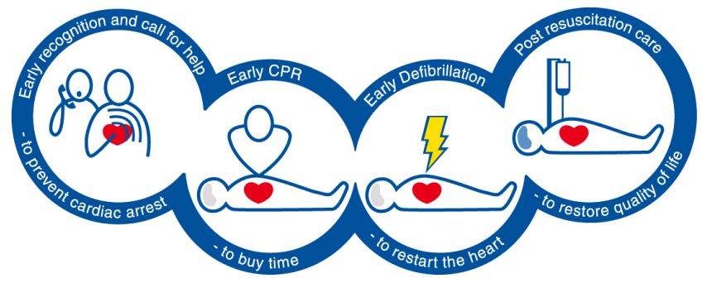
Chain of survival
Therefore, early recognition and treatment of deteriorating patients is the key to preventing deaths and also in identifying patients in whom CPR is not appropriate.

Slide 7
Chain of survival 2025 AHA updated
Summary of Key Issues and Major Changes
Universal chain of survival
A single Chain of Survival is used across adult and pediatric in hospital cardiac arrest (IHCA) and out-of-hospital cardiac arrest (OHCA).
In creating this singular chain, it is acknowledged that
before cardiac arrest, prevention and preparedness can both avoid the need for and optimize resuscitation

Slide 8

Single Chain of survival (IHCA and OHCA)
Updated 2025 American Heart Association recommendation

Slide 9
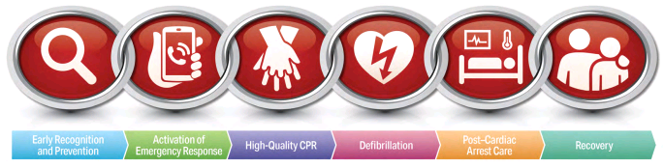
Old Chain of survival 2020 AHA…
IHCA for adults
2020 American Heart Association recommendation

Slide 10
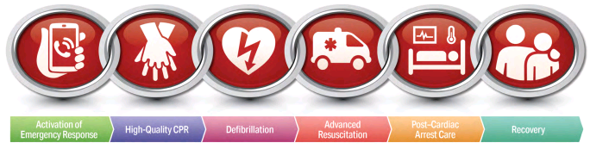
Chain of survival …
OHCA for adults
2020 American Heart Association recommendation
American Heart ssociation

Slide 11
Chain of survival …
Recovery and survivorship:
After discharge from the hospital, cardiac arrest survivors can have
physical, cognitive, and emotional challenges and may need ongoing therapies and interventions

Slide 12
Cont…
Difference b/n OHCA VS.IHCA
OHCA is usually considered separately from IHCA as there are
clinically important differences in population, medical response and outcome.
Further, as a consequence of
continuous monitoring,
higher nurse and doctor staffing and supportive therapies,
the medical response is also necessarily different to that on the ward.
Notes:
OHCA (Out-of-hospital cardiac arrest)
IHCA (In-hospital cardiac arrest)

Slide 13
Incidence of CA
The incidence of ICU-CA has not been widely reported.
The true incidence and outcome of CA within ICU is unknown.
The reported incidence of cardiac arrest in the ICU
In a systematic review, 5.6 to 78.1 cardiac arrests per 1000 ICU admissions (Efendijev et al. 2014)
5 to 78 per 1000 admissions (Richard A Armstrong et.al; 2019: systemic meta-analysis).

Slide 14
Cont…
Anesthetists face cardiac arrest patients in day-to-day activities in the OR and outside the OR
Regular assessment of simple vital signs are essential
in recognizing critical illness and helping to predict cardio respiratory arrest
Patients in the ICU and OR are monitored extensively and, as a consequence, there should be no delay in diagnosing a CA
Effective monitoring and correction of physiological variables is the key in the prevention and treatment
Notes:
Rates for survival to discharge from in-hospital arrest are about 18% in adults and 27% in children.
Within the hospital, the operating room is the location where CPR has the highest rate of success.
Cardiac arrest occurs approximately seven times for every 10,000 anesthetics.
The cause for the arrest is anesthesia related approximately 4.5 times for every 10,000 anesthetics, but mortality from these arrests is only
0.4 per 10,000 anesthetics. Thus, resuscitation is successful approximately 90% of the time in anesthesia-related cardiac arrests.

Slide 15
Reversible causes of cardiac arrest
Potential causes for which specific treatment exists must be considered during CA.
For ease of memory, these are divided into two: H’s and T’s
‘H’s | ‘T’s
Hypoxia | Thrombosis- pulmonary embolism or cardiac thrombosis
Hydrogen ion (Acidosis)
Hypovolemia | Tension pneumothorax
Hypokalemia / hyperkalemia | Toxins/drugs
Hypothermia | Tamponade-cardiac

Slide 16
Group discussion
Be in a group of 2
Time allowed –
5 minutes for discussion & 3 minutes for reflection
Discuss on given part ( ‘H’s or ‘T’s) – What are the predisposing factors to each reversible causes?
- How can you assess it? – What interventions (management) can be taken?

Slide 17
Predisposing factors and management to the ‘H’s
‘H’s | Potential factor | intervention
Hypoxia | Airway obstruction, lung pathology (ARDS, pneumonia, pulmonary edema, pneumothorax or hemothorax )… | R/O and treat the cause Oxygen during CPR. Check carefully the tracheal tube if intubated Make sure there is adequate chest rise and bilateral breath sounds
Hydrogen ion (acidosis) | Respiratory failure, shock, DKA, Renal failure, drug overdose, severe hypoxia | Treat the underlying cause Optimize oxygenation and ensure adequate ventilation
Hypovolemia | Severe hemorrhage: trauma, GI bleeding or rupture of an aortic aneurysm. | Rapid fluid resuscitation Surgery to control bleeding
Hyperkalemia or hypokalemia | ARF, systemic disease… RRT | 10 mL 10% calcium chloride IV or 30 mL 10% calcium gluconate IV. Potassium replacement
Hypothermia | Deranged temperature regulation secondary to sepsis Drowning | Rewarming or attempts to raise core temperature

Slide 18
Predisposing factors and management to the ‘T’s
‘T’s | Potential factor | Intervention/Treatment
Thrombosis-pulmonary/coronary | Long bone fracture CHF, VHD, Spinal cord injury, Stroke, Obesity, Immobility… | PE - continuation of chest compressions and where available administration of a thrombolytic drug.
Tension pneumothorax | Chest trauma… | Needle thoracocentesis- in the mid-clavicular line in the 2ICS
Toxins/drugs | Accidental or deliberate ingestion of therapeutic or toxic substances | Supportive Specific antidotes if available
Tamponade-cardiac | penetrating chest trauma | Needle pericardiocentesis or resuscitative thoracotomy. Use 16G or 18G, 15cm or longer needle attached to a large syringe.

Slide 19
Causes of ICU-CA
H’s
Hypoxia – secondary to ARDS, pneumonia, pulmonary edema, pneumothorax or hemothorax
Hypovolemia – could be from bleeding in the extracorporeal circuit or in the patient as a result of excessive anticoagulation or deranged coagulation due to sepsis
Hyper/hypokalemia/metabolic disturbance – Initially hyperkalemia could be due to ARF whereas later electrolyte depletion due to RRT (hypokalemia, hypophosphatemia, hypomagnesemia) may manifest as cardiac arrest.
Hypothermia – could be from deranged temperature regulation secondary to sepsis

Slide 20
Cont…
T’s
Tension pneumothorax – secondary to potential pleural punctures during CVC in a patient receiving PPV
Thrombosis/pulmonary emboli,
Tamponade cardiac,
Toxins

Slide 21
Cont…
Cardiac
Ischemic heart disease (myocardial infarction)
Heart failure
Arrhythmia of different origin
Myocardial ischemia
Tamponade cardiac
Aortic stenosis
Ventricle wall rupture
Valvular disease

Slide 22
Cont…
Other
Sepsis
Cerebral bleeding/infarction
Aortic dissection
Aortic aneurysm with rupture
Cerebral seizure
Oesophageal varicose bleeding
Other non-dominant causes

Slide 23
Cont…
Anaphylaxis – could be to preservatives, blood products or any other allergen the patient might have been exposed to.
Human and technical errors –
involving drug prescription, preparation, dosage, compatibility, administration; inappropriate ventilator settings

Slide 24
Signs of cardiac arrest
Absence of pulse on carotid, femoral or brachialis arteries
Absence of blood pressure
Respiratory arrest – may be in 30 seconds after cardiac arrest
Pallor or cyanosis quickly follows cardiac arrest
Cardiac sounds cannot be heard over the pericardium
Absence of bleeding in the wound
Enlargement of pupils – may be in 90 seconds after cardiac arrest

Slide 25
Components of resuscitation from CA
The major components of resuscitation from cardiac arrest are: ABCDE
Airway
Breathing
Circulation
Drugs
Electrical therapy

Slide 26
Cont…
CPR can be divided into
Basic life support (BLS)
performed without additional equipment
It includes basic airway management, rescue breathing, manual chest compressions, and early defibrillation
Advanced cardiac life support (ACLS)
Encompassing all the cognitive and technical skills necessary for resuscitation.

Slide 27
References
Paul G. Barash: Handbook of Clinical Anesthesia (6th edition). Lippincott Williams & Wilkins publications, Inc., 2009: pp. 1532- 46.
Travers, A. H., Rea T. D., Bobrow, B. J. et.al.. CPR overview: American Heart Association guidelines for cardiopulmonary resuscitation and emergency cardiovascular care. 2010: 122 (4)
Atkins DL, Berger S, Duff JP, et.al. Part 11: pediatric basic life support and cardiopulmonary resuscitation quality: 2015 American Heart Association Guidelines Update for Cardiopulmonary Resuscitation and Emergency Cardiovascular Care. Circulation. 2015;132(suppl 2):S519–S525.
Ashish R. Panchal, Katherine M. Berg, et.al. 2018 American Heart Association Focused Update on Advanced Cardiovascular Life Support Use of Antiarrhythmic Drugs During and Immediately After Cardiac Arrest. Circulation. 2018;138:e740–e749 .Availble at: @2018 American Heart Association, Inc. https://www.ahajournals.org/journal/circ
Efendijev I, Nurmi J, Castre´ n M, et al. Incidence and outcome from adult cardiac arrest occurring in the intensive care unit: a systematic review of the literature. Resuscitation 2014; 85: 472–479
Richard A Armstrong1 , Caroline Kane1, Fiona Oglesby2, Katie Barnard3 , Jasmeet Soar1 and Matt Thomas. The incidence of cardiac arrest in the intensive care unit: A systematic review and meta-analysis. Journal of the Intensive Care Society. 2019, Vol. 20(2):144–154
Joyner et al. Pediatric Basic Life Support: 2025 AHA/AAP Guidelines for CPR and ECC.
Kleinman et al. Adult Basic Life Support: 2025 AHA Guidelines for CPR and ECC

